Slide 1
Introduction to Asterisk Patterns
Discover the art of creating beautiful alphabet patterns using asterisks (*) in Python. Explore the versatility of this simple yet powerful technique and unlock your creativity in programming.

Slide 2
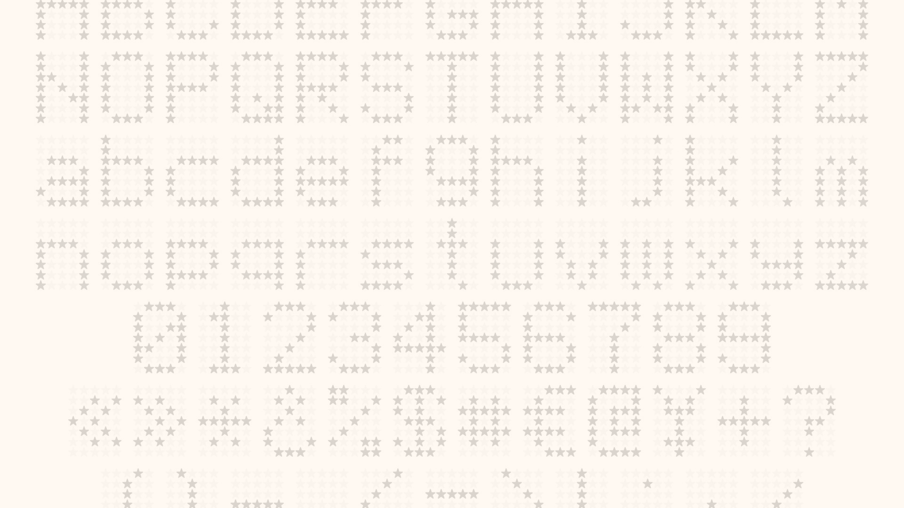
Printing Alphabets with Asterisks
1
Basic Patterns
2
Uppercase and Lowercase
3
Scaling and Spacing
Start by printing single letters using asterisks to form the shapes.
Adjust the size and spacing of the asterisks to control the overall size and appearance of the letters.
Experiment with both uppercase and lowercase letters to see the different patterns they create.

Slide 3
Nested Loops for Alphabet Patterns
Nested Loops
Rows and Columns
Flexibility
Use nested for loops to create more complex patterns by nesting the print statements for each asterisk.
Control the number of rows and columns to shape the overall pattern of the letters.
Nested loops allow for dynamic and customizable patterns, enabling you to experiment with different designs.

Slide 4



Customizing Alphabet Size and Spacing
Size
Spacing
Alignment
Adjust the number of asterisks used to control the overall size of the letters.
Vary the spacing between the asterisks to create different levels of letter separation.
Experiment with left, right, or center alignment to achieve the desired visual effect.

Slide 5
Handling Uppercase and Lowercase Letters
Distinct Patterns
Case Sensitivity
Uppercase and lowercase letters can create vastly different patterns when rendered with asterisks.
Your code must be able to correctly handle both uppercase and lowercase letter inputs.
Flexibility
Consistency
Allowing for both cases expands the range of designs and artistic expressions possible.
Maintain a consistent approach to handling case to ensure clean and uniform outputs.

Slide 6
Challenges and Considerations
1
Edge Cases
Anticipate and handle edge cases, such as non-alphabetic characters or empty inputs.
2
Performance
Optimize your code for efficiency, especially when dealing with large pattern sizes.
3
Creativity
Embrace the creative potential of this technique and explore unique pattern designs.

Slide 7
Example Code Walkthrough
Define Dictionary
Assign format of alphabets using ( * ) in dictionary
Input()
Get input string from user
For range()
To check range of pattern assigned
len(), print()
To check length of stored word given from user input and print result

Slide 8

Conclusion
Mastering Asterisk Patterns
Explore the endless possibilities of creating unique and visually striking alphabet patterns using asterisks in Python.

